Slide 1
Enabling Ontology-based Access to Streaming Data Sources
Venue here
Jean-Paul Calbimonte¹, Oscar Corcho¹, Alasdair J G Gray²
¹Ontology Engineering Group. Departamento de Inteligencia Artificial.
Facultad de Informática, Universidad Politécnica de Madrid.
Campus de Montegancedo s/n. 28660 Boadilla del Monte. Madrid. Spain
jp.calbimonte@upm.es;ocorcho@fi.upm.es
²School of Computer Science, The University of Manchester,
Oxford Road, Manchester M13 9PL, United Kingdom
a.gray@cs.man.ac.uk

Slide 2
Outline
Introduction & Motivation
Background
Approach
Mapping Streams to Ontologies
SPARQL Stream
Query Translation
Example
Future work
Conclusions

Slide 3
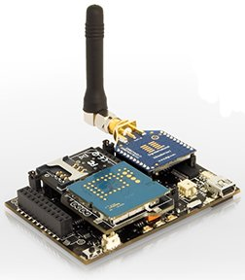
Introduction & Scope
Sensor technologies
Ubiquitous data capture
Data processing
Cheap
Noisy, Unreliable
Low computational, power resources, storage
Streaming Data
Continuously appended data
Potentially infinite
Time-stamped tuples
Continuous queries
Latest used in queries
(t9, a1, a2, ... , an)
(t8, a1, a2, ... , an)
(t7, a1, a2, ... , an)
...
...
(t1, a1, a2, ... , an)
...
...
Streaming Data
Applications in security surveillance, healthcare provision, environmental monitoring, you name it.

Slide 4
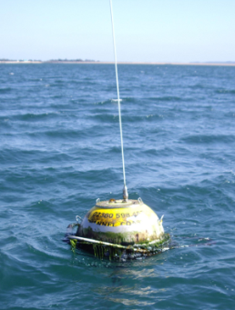
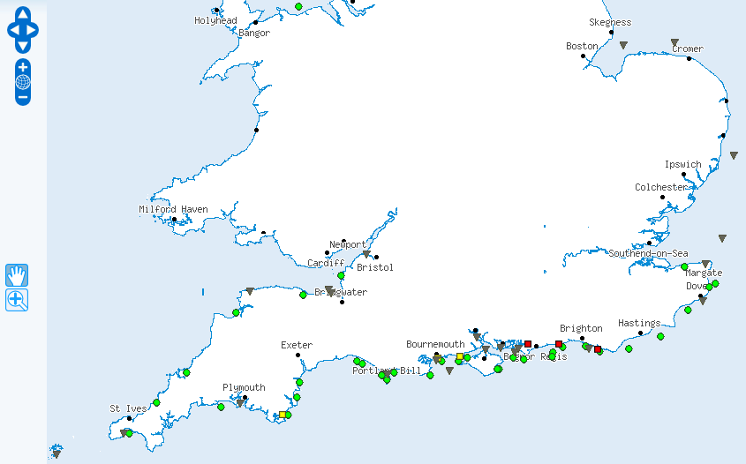




Motivation
Flood risk alert:
South East England
Wave,
Wind,
Tide
Real-time
data
Emergency planner
Meteorological forecasts
Flood defences data
Other sources
...
...
...
Detect conditions likely to cause a flood
Present data model in terms of the user domain: e.g. Flood risk assessment
Example:
“provide me with the wind speed observations average over the last minute, if it is higher than the average of the last 2 to 3 hours”

Slide 5
Motivation
Ontologies can be used as such a common model
Put something nice here
Answer the requirements:
Establish mappings between ontological models and streaming data source schemas
Access streaming data sources through queries over ontology models

Slide 6
Background – Ontology-based Data Access
Generate Semantic Web content from existing relational data sources
Ontological Models
R₂O + ODEMapster
D2RQ
SquirrelRDF
RDBToOnto
Relational.OWL
SPASQL
Virtuoso
MASTRO
e.g. SPARQL
Query/Data Transformation
Mapping
Document
Ontology-based Data Access
e.g. SQL
Relational
Schemas

Slide 7
Background – Querying Relational Data Streams
Streaming Data
STREAM
Aurora/Borealis
Cougar
TinyDB
SNEE
(t9, a1, a2, ... , an)
(t8, a1, a2, ... , an)
(t7, a1, a2, ... , an)
...
...
(t1, a1, a2, ... , an)
...
...
Window [t7 - t9]
Streaming Data
e1
e1
e2
e1
e2
e3

Slide 8

Motivation
Heterogeneous sources: schemas, stream rates, QoS, delivery mechanisms
Distributed sources
Semantic heterogeneity
Semantic data provision only for stored data
Need for live streaming continuous queries
Sensor Network
Decl. Query
Integrate
Database Data
Integrated view
Stream Data

Slide 9
Main Research Questions
Provide semantic query interfaces for streaming data
Expose streaming data for the semantic web
Integrate streaming sources through ontology mappings
Optimize distributed query execution for streaming + stored data
Ontology-based Data Access
Heterogeneous data Integration
Streaming Data Access
Distributed Query Processing
RDF Streams Querying
q
Semantic Integrator

Slide 10
General Approach
Related work: literature and existing approaches
Identify limitations
Potential gaps
Incremental solution proposals
Ontology-based data access to streams
Semantic streaming query language
Semantic integration for distributed streams
Stream query optimization
Evaluation
SemSorGrid4Env project
Benchmarks, LinearRoad

Slide 11
Proposed Solution
Client
SPARQL_{STR} (O_{g})
Query reconciliation
Ontology-to-Ontology mappings
SPARQL_{STR} (O₁ O₂ O_{n})
Query translation
Ontology-to-Source mappings
Sensor Network (S₁)
SPARQL_{STR} algebra(S₁ S₂ S_{m})
Rewriter
Relational DB (S₂)
Rewriter
Optimizer
Query Evaluator
Stream Engine (S₃)
Distributed Query Processing
RDF Store (S_{m})
Ontology-based Streaming Data Access Service
11

Slide 12
So Far…
Ontology-base data access
Define stream extensions for R2O
Define SPARQL_{STR} language syntax and semantics
Enable engine support for « S2O » documents, SPARQL_{STR} queries
Enabled engine support for SNEEql translation and connection
Limited to non-distributed scenario initially

Slide 13
So Far...
v
envdata_westbay
envdata_chesil
Feature
v
v
locatedInRegion
envdata_milford
Observation
v
S₂O
Mapping
hasObservationResult
Streams
envdata_hornsea
Ontologies
envdata_rhylflats
observedProperty
Region
Timestamp: long
Hs : float
Lon: float
Lat: float
xsd:float
WaveHeightProperty
PREFIX cd: <http://www.semsorgrid4env.eu/ontologies/CoastalDefences.owl#>
PREFIX sb: <http://www.w3.org/2009/SSN-XG/Ontologies/SensorBasis.owl#>
PREFIX rdf: <http://www.w3.org/1999/02/22-rdf-syntax-ns#>
SELECT ?waveheight ?wavets ?lat ?lon
FROM STREAM <http://www.semsorgrid4env/ccometeo.srdf>
WHERE
{
?WaveObs a cd:Observation;
cd:observationResult ?waveheight;
cd:observationResultTime ?wavets;
cd:observationResultLatitude ?lat;
cd:observationResultLongitude ?lon;
cd:observedProperty ?waveProperty;
cd:featureOfInterest ?waveFeature.
?waveFeature a cd:Feature;
cd:locatedInRegion cd:SouthEastEnglandCCO.
?waveProperty a cd:WaveHeight.
}
(SELECT Lon,timestamp,Hs,Lat FROM envdata_rhylflats) UNION
(SELECT Lon,timestamp,Hs,Lat FROM envdata_hornsea) UNION
(SELECT Lon,timestamp,Hs,Lat FROM envdata_milford) UNION
(SELECT Lon,timestamp,Hs,Lat FROM envdata_chesil) UNION
(SELECT Lon,timestamp,Hs,Lat FROM envdata_perranporth) UNION
(SELECT Lon,timestamp,Hs,Lat FROM envdata_westbay) UNION
(SELECT Lon,timestamp,Hs,Lat FROM envdata_pevenseybay)
SPARQL_{STR}
SNEEql

Slide 14
Future Works
Ontology-based data access
SPARQL construct expressions, aggregates, projected operators
Implement adapters for other streaming sources
Add query rewriting algorithms
Ontology-based streaming data integration
Horizontal & vertical integration
Integrate streaming + stored data
RDF data sources integration
Streaming query optimization
Analyze cost models
Streaming sources statistics and metadata
Quantitative evaluation
14

Slide 15
Thanks!
Enabling Semantic Integration of Streaming Data Sources

Slide 16
References
Arasu, A., Babcock, B., Babu, S., Cieslewicz, J., Datar, M., Ito, K., Motwani, R., Srivastava, U., Widom, J.: Stream: The stanford data stream management system. In Garofalakis, M., Gehrke, J., Rastogi, R., eds.: Data Stream Management. (2006)
Sahoo, S.S., Halb, W., Hellmann, S., Idehen, K., Jr, T.T., Auer, S., Sequeda, J., Ezzat, A.: A survey of current approaches for mapping of relational databases to RDF. W3C (January 2009)
Arasu, A., Babu, S., Widom, J.: The cql continuous query language: semantic foundations and query execution. The VLDB Journal 15(2) (June 2006) 121-142
Brenninkmeijer, C.Y., Galpin, I., Fernandes, A.A., Paton, N.W.: A semantics for a query language over sensors, streams and relations. In: BNCOD '08. (2008) 87-99
Barrasa, J., Oscar Corcho, Gomez-Perez, A.: R2O, an extensible and semantically based database-to-ontology mapping language. In: SWDB2004. (2004) 1069-1070
Lenzerini, M.: Data integration: a theoretical perspective. In: PODS '02. (2002) 233-246
Barrasa Rodriguez, J., Gomez-Perez, A.: Upgrading relational legacy data to the semantic web. In: WWW '06. (2006) 1069-1070
Barbieri, D.F., Braga, D., Ceri, S., Della Valle, E., Grossniklaus, M.: C-sparql: A continuous query language for rdf data streams (to appear). In: (IJSC). (2010)
Bolles, A., Grawunder, M., Jacobi, J.: Streaming SPARQL - extending SPARQL to process data streams. In: ESWC 08. (2008) 448-462
Kossmann, D.: The state of the art in distributed query processing. ACM Comput. Surv. 32(4) (2000) 422-469
Perez, J., Arenas, M., Gutierrez, C.: Semantics and complexity of sparql. ACM Trans. Database Syst. 34(3) (2009) 1-45
Calvanese, D., De Giacomo, G., Lembo, D., Lenzerini, M., Rosati, R.: DL-Lite: Tractable description logics for ontologies. In: AAAI 2005. (2005) 602-607
Poggi, A., Lembo, D., Calvanese, D., Giacomo, G.D., Lenzerini, M., Rosati, R.: Linking data to ontologies. J. Data Semantics 10 (2008) 133-173
Perez-Urbina, H., Horrocks, I., Motik, B.: Ecient query answering for owl 2. In: ISWC 2009. (2009) 489-504

Slide 17
Introduction & Scope
SemSorGrid4Env
Development of an integrated information space where new sensor networks can be easily discovered and integrated with existing ones and possibly other data sources (e.g., historical databases)
Rapid development of flexible and user-centric decision support systems that use data from multiple autonomous independently deployed sensor networks and other applications.

Slide 18
Ontology-based data access & integration
ODEMapster
SquirrelRDF
RDBToOnto
Relational.OWL
SPASQL
Virtuoso
D2RQ
MASTRO
R₂O + ODEMapster
ODEMQL
MySQL
Oracle
...others
Ontological query
Transform
relational query
Ontological model
Database
OWL
Mapping
R₂O
OBSERVER
SIMS
Carnot
DWQ
PICSEL
MOMIS
Ontological query
Ontological model
Transform
relational query
Databases
Mappings

Slide 19
Background: Approaches & Technologies
DSMS
DQP
QP
S-RDF
Ontology-based Data Access
Heterogeneous data Integration
Streaming Data Access
Distributed Query Processing
RDF Streams Querying
R₂O + ODEMapster
SNEE/SNEEql
C-SPARQL extensions
q
Semantic Integrator
19

Slide 20
S2O: Mapping Streams to Ontologies
conceptmap-def WindSpeedMeasurement
uri-as
concat('ssg4env:WindSpeedMeasurement_',
windsamples.sensorid,windsamples.ts)
described-by
attributemap-def hasSpeed
operation "constant"
has-column windsamples.speed
dbrelationmap-def isProducedBy toConcept Sensor
joins-via
condition "equals"
has-column sensors.sensorid
has-column windsamples.sensorid
conceptmap-def Sensor
uri-as
concat('ssg4env:Sensor_',sensors.sensorid)
described-by
attributemap-def hasName
operation "constant"
has-column sensors.sensorname
S:WindSamples
ts
speed
direction
sensorid
WindSpeedMeasurement
hasSpeed xsd:float
Measurement
isProducedBy
T:Sensors
- sensorid
sensorname
Sensor
hasName xsd:string
20

Slide 21
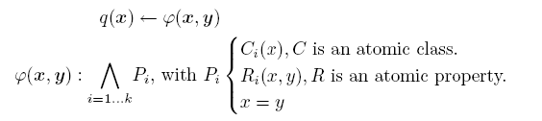


Query Transformation Semantics
Conjunctive Queries
Mapping
expression
over streaming sources
conjunctive
query

Slide 22
From SPARQL_{STR} to SNEEql
Semantic Integrator
PREFIX fire: http://www.semsorgrid4env.eu#
PREFIX rdf: http://www.w3.org/1999/02/22-rdf-syntax-ns#
SELECT ?speed ?name
FROM STREAM <http://www.ssg4env.eu/Readings.srdf>
[RANGE 10 MINUTE STEP 1 MINUTE]
WHERE {
?WindSpeed a fire:WindSpeedMeasurement;
fire:hasSpeed ?speed;
fire:isProducedBy ?sensor;
fire:hasTimestamp ?time.
?sensor a fire:Sensor;
fire:hasName ?name.
}
SELECT concat( ‘ssg4env.eu#Sensor' , sensors.sensorid ) as a1 ,
( sensors.sensorname ) as name
FROM sensors
SELECT concat(‘ssg4env.eu#WindSpeedMeasurement' ,
windsensor.id , windsensor.ts ) as a1 ,
( windsensor.speed ) as speed
FROM windsensor[ FROM NOW - 10 TO NOW MIN]
SELECT concat(‘ssg4env.eu#WindSpeedMeasurement' ,
windsensor.id, windsensor.ts ) as a1 ,
concat( ‘ssg4env.eu#Sensor' , sensors.sensorid ) as a2
FROM sensors, windsensor[ FROM NOW - 10 TO NOW MIN]
WHERE ( sensors.sensorid = windsensor.id )
Work in progress: removing redundant queries, basic optimisations, more complex scenarios
22

Slide 23
Semantic Integration Interactions
Semantic Integrator
Streaming Data Resource
Stored Data Resource
Consumer
IntegrateAs (StrRes,StoRes,map)
IntegratedRes
SPARQLExecuteFactory(IntegratedRes, query)
SNEEqlExecuteFactory(StreamingRes, querySNEEql)
access StreamingRes
GetResponseItem(access StreamingRes)
repeat
results
SQLExecuteFactory(StoredRes, querySQL)
results
access IntegratedRes
GetResponseItem(access IntegratedRes)
23

